Slide 1
The Contribution of Plants and Pollution to Tucson’s Urban Ozone Problem
Richard Pepel
(department of Chemical and environmental engineering)
Mentor: Dr. Eric Betterton
(department of hydrology and atmospheric sciences)

Slide 2
Background
In 2018, ozone levels in Tucson exceeded the Environmental Protection Agency’s national air quality standards (70 ppb) for the first time
Ground-level ozone is a respiratory health risk and an environmental hazard
The recipe for ozone production is:
Volatile Organic Compounds (VOCs) + Nitrogen oxides (NOx) + Sunlight → Ozone
Tucson’s VOC profile was unknown prior to this project
The goal of this project is to determine the following in Tucson:
The limiting reagent (between VOCs and NOx) for ozone production
How much of an impact VOCs from plants have on ozone production
Whether seasonal VOC trends can be observed

Slide 3
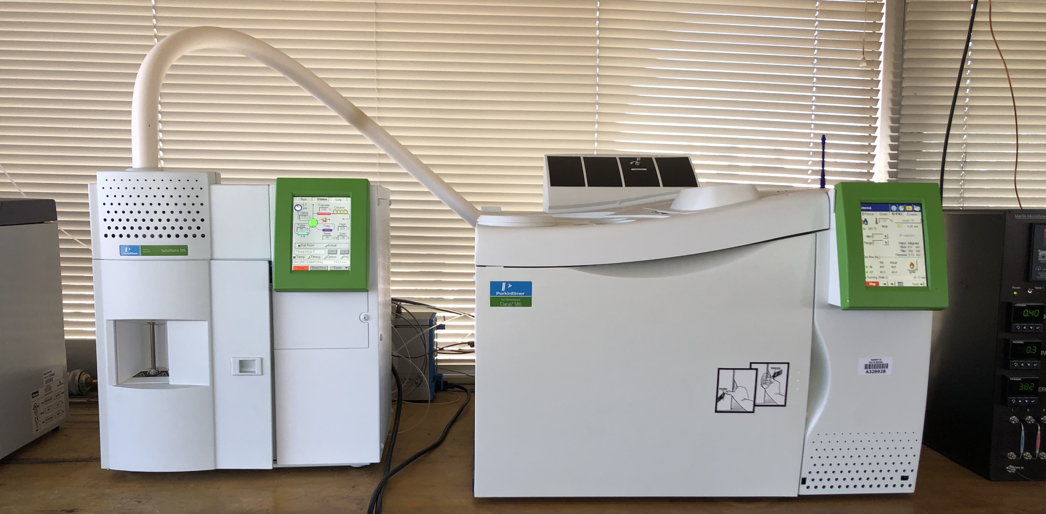
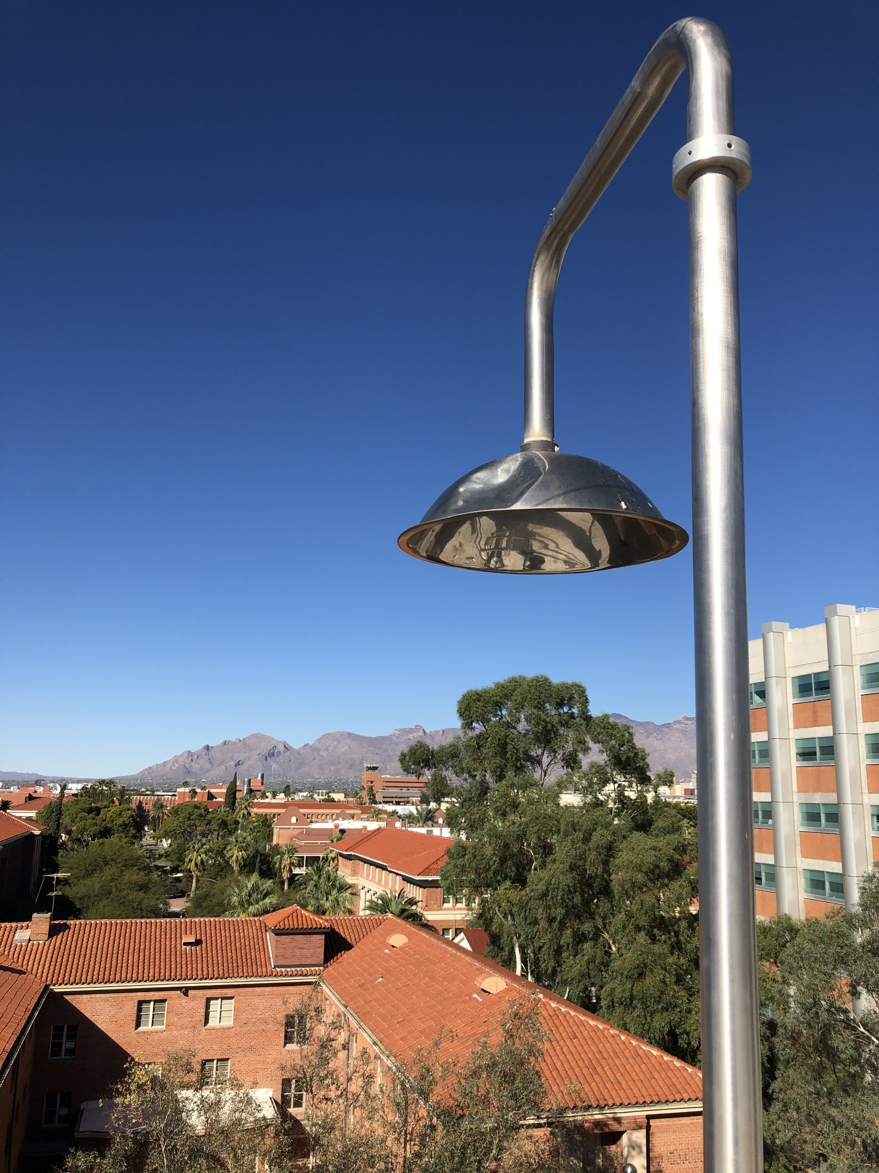
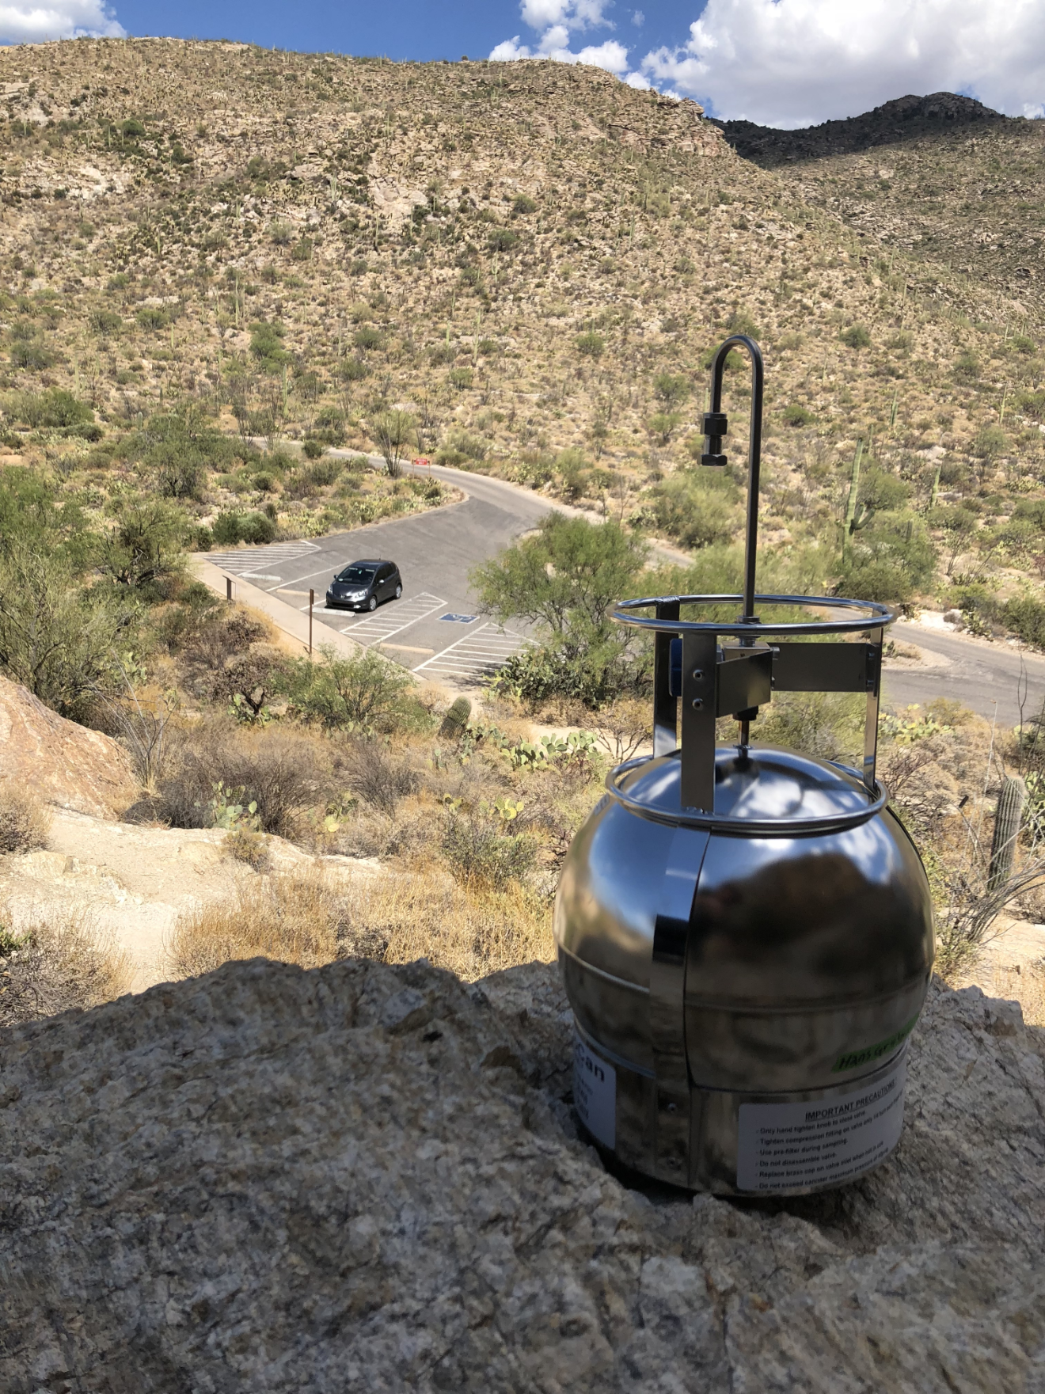
Procedure
Gas Chromatography is used to determine the concentration and speciation of VOCs
Ambient air samples are taken directly on the Physics and Atmospheric Sciences (PAS) rooftop lab at 1 or 3-hour intervals
Summa cannisters were also used to take samples throughout Pima County
Over 60 Summa cannister samples and over 12,000 ambient air samples have been taken
Gas Chromatograph used to analyze air samples
PAS rooftop sampler
Summa cannister

Slide 4
Sampling Locations
Summa cannister sampling locations

Slide 5
Anthropogenic vs. Biogenic VOCs

Slide 6
VOC Concentration vs. Ozone Concentration

Slide 7
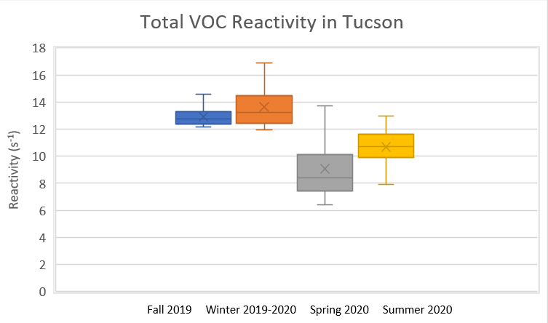
Seasonal Reactivity
$$Total reactivity{ [s}^{−1}]=\sum{k [C_{i}]}$$
$$k=individual VOC production$$
$$rate constant [{ppb}^{−1}s^{−1}]$$
$$C_{i}=individual VOC$$
$$concentration [ppb]$$

Slide 8
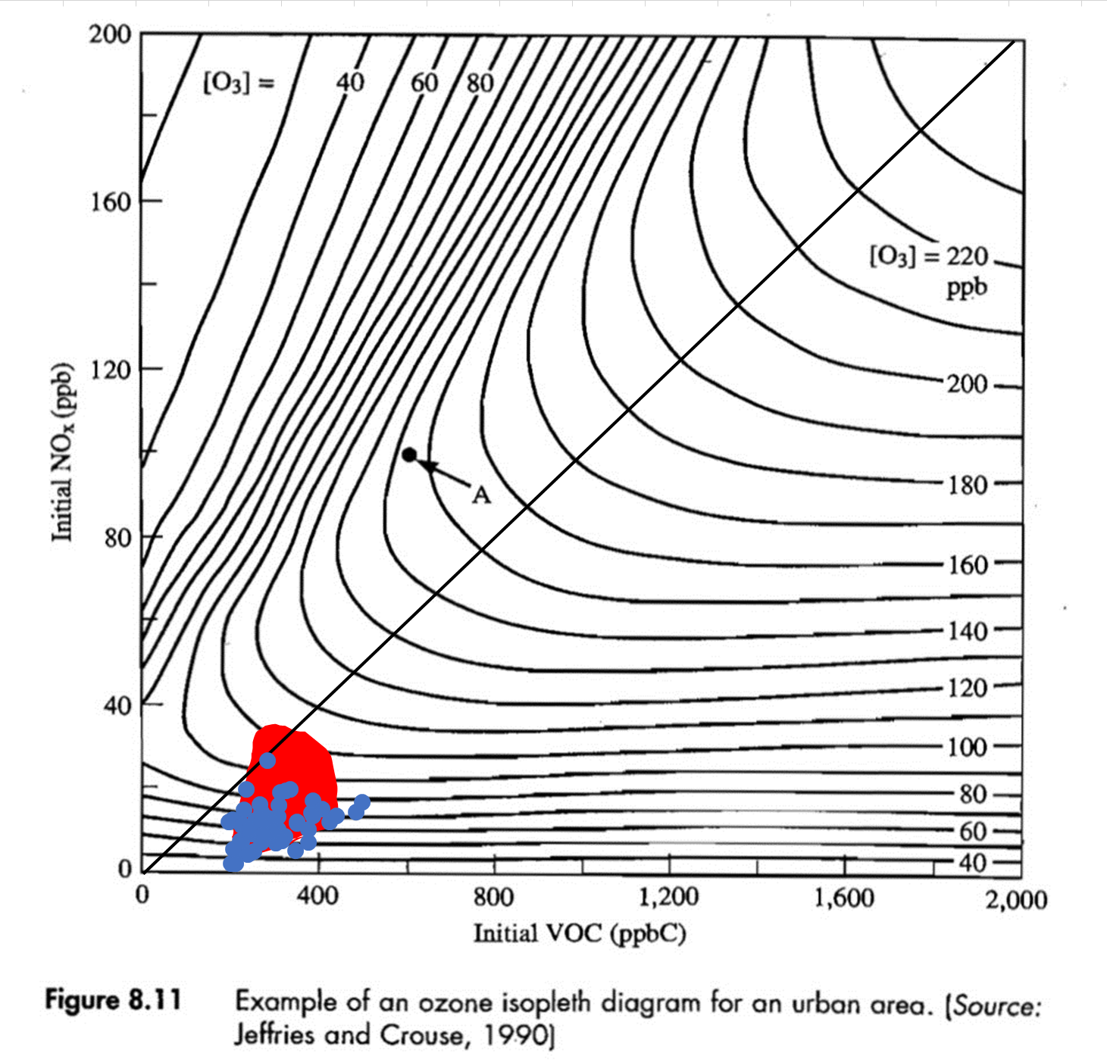
Tucson and Phoenix – Ozone Isopleth
- Tucson
- Phoenix
(Estimate)

Slide 9
Conclusions
Plant emissions are responsible for a significant amount of VOC production, especially on days with elevated ozone levels
The largest contributors to ozone production in Tucson are anthropogenic emissions
Ozone production generally increases with VOC concentrations
Total VOC reactivity varies seasonally
Tucson appears to be NOx-limited
Tucson NOx appears to be lower than Phoenix
Tucson VOC appears to be comparable to Phoenix
Further research is required to confirm these findings

Slide 10
Thank you
Thank you to the Arizona Space Grant Consortium and to everyone involved in this project:
Michelle Coe – Arizona Space Grant Consortium
Dr. Chandra Holifield Collins – Arizona Space Grant Consortium
Dr. Eric Betterton – Department of Hydrology and Atmospheric Sciences
Kyle Rine – Department of Hydrology and Atmospheric Sciences
Kisiel Chapman – Department of Hydrology and Atmospheric Sciences
Dr. Eduardo Saez – Department of Chemical and Environmental Engineering
Ruby O’Brien-Metzger – Department of Aerospace and Mechanical Engineering
Diana Picón – Department of Biosystems Engineering

Slide 13
NOx Concentration vs. Ozone Concentration

